Slide 1
Generics: A Retrospective
Type Parameters for
.NET Programming Languages
Don Syme
Andrew Kennedy
Claudio Russo
16 June 2003

Slide 2
Outline
Introduction & project summary
  The problem space, its difficulties and our general approach
Some big questions:
  Concrete achievements?
  What has been truly hard about this project?
  Is this good R as well as good D?
  What do we know now that we didn’t know before this project started?
Looking ahead
  Some interesting recent issues
  Our future scientific agenda

Slide 3
Type parameters: Introduction
For:
Collection Classes,
Algorithms
Benefits:
Code Reuse,
Faster Code,
Safer Programming
Generic Classes,
Generic Interfaces,
Generic Structs,
Generic Code
Not exactly a new idea...
public class Stack<T>
{
public Stack() { nitems = 0; items = new T[10]; }
public T Pop() { return items[--nitems]; }
public void Push(T x) { ... ; items[nitems++] = x; }
public bool IsEmpty() { ... }
private T[] items;
private int nitems;
}
C++
Ada
Stack<int> st;
..
switch (oper)
{
case ‘*’ :
st.Push (st.Pop() * st.Pop());
break;
case ‘*’ :
...
}
ML
Eiffel
Haskell
C#
Mercury
Java
Using a Generic Class

Slide 4
It looks oh so simple...
  In a fundamental calculus (e.g. System F)
  Without type parameters:
  λf:int→int. λx:int. f(f(x))
  λf:string→string. λx:string. f(f(x))
  With type parameters:
  ΛA. λf:A→A. λx:A. f(f(x))
  In an ML-like language:
    let twice (A) (f: A→A) (x:A) = f(f(x))
    let ten = twice :int (λy. y + y) 5 → 10
    let abab = twice :string (λy. y ^ y) “ab” → “abab”

Slide 5
And in an OO language (C#)
  Without type parameters:
  class IntList { int x[]; int size; }
  class StringList { string x[]; int size; }
  With type parameters:
  class List<T> { T x[]; int size; }
  Also:
  parameterized interfaces
  parameterized methods

Slide 6
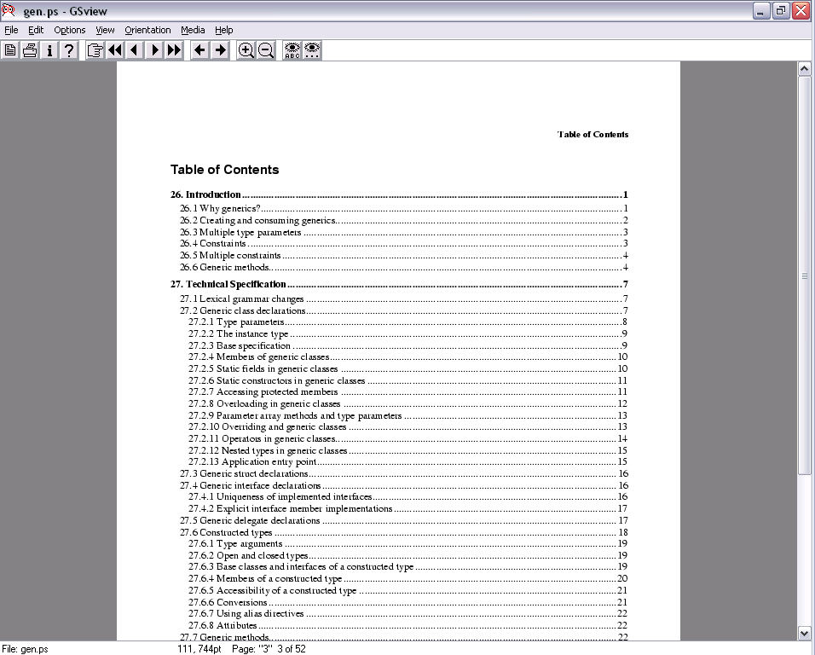
And you can even do a language design (e.g. C#)...

Slide 7
But difficulties lurk everywhere...
All previous design/implementations of type-parameterization effectively lack something really significant:
  dynamic inspection of software objects/components
  dynamic linking
  existential and/or runtime types
  on-the-fly code generation
  sufficient generality
  expected code-specialization properties

Slide 8
And don’t forget...
.NET has added:
  cross-language requirements
  interactions with serialization
  interactions with remoting
  interactions with garbage collection
  interactions with “application domains”
  stringent performance and compilation requirements

Slide 9
Languages with type parameters
Standard ML
Eiffel
O’Caml
C++
Ada
Clu
GJ
Haskell
Mercury
Miranda
Pizza
Modula-2

Slide 10
Today’s widely-used languages with type parameters
C++

Slide 11
Today’s modern widely used languages with type parameters
(e.g. modern = dynamic linking)

Slide 12
Example issues/interactions...
Dynamic linking
Multiple-language
Cross-language

Slide 13
Issue 1: Dynamic Linking & Runtime Structures
Library
List<T>
(Logical components)
Component
A
Component
B
App

Slide 14
Issue 1: Dynamic Linking & Runtime Structures
Library
List<T>
Logical components
Component
A
Component
B
App
LibCls1
Runtime Data Structures
LibCode
ACls1
BCls1
ACode
BCode
AppCls1
AppCode

Slide 15
Issue 1: Dynamic Linking & Runtime Structures
Problem 2: Many aspects of generics require “per-instantiation” code or descriptors. These runtime data structures often have to be unique.
Problem 1: Newly loaded components may specify new instantiations
Library
List<T>
Component
1
List<string>
List<int>
Component
2
List<int>
App
List<string>
Thus generics+dyn-link really require
a JIT
a sophisticated link/loader
List<int>

Slide 16
Our general solution...
The implementation of generics must go in the virtual execution environment (VM):
  The interactions with other features are just too strong
  e.g. it’s the only way to solve both the dynamic linking and the cross-language working problems
This fits in well with .NET

Slide 17
here...
here...
...and here.
here...
VB
VC++
C#
...
ML
also here...
Add support for
generics/
type parameters...\
Common IL
Note this code has to cope with all the interactions with other features
Common Language Runtime
Loader
JIT
Verifier
...
GC
Native
Code

Slide 18
Issue 2: Multiple languages
C++
Give me template specialization
C++
Can I write class C<T> : T
C#
Just give me decent collection classes
C++
And template meta-programming
Visual Basic
Don’t touch my language!
Java
Run-time types please
Eiffel
All generic types covariant please
ML
Functors are cool!
Haskell
Rank-n types? Existentials?
Kinds?
Type classes?
Scheme
Why should I care?

Slide 19
Issue 3: Cross-language interoperation
Eiffel
C++
C#
...
ML
Principles:
Features are good (big benefits for a “rich” cross-language interop experience)
Features are bad (if all languages must support the feature)
Leads to a bizarre “LCD”/”GCD” effect
For example, what if there are languages that don’t consume generics?
Languages must all be able to understand each other’s external interfaces

Slide 20
X-lang + Multi-lang = Tricky
Eiffel
C++
C#
...
ML
But Microsoft is adamant that co-variance should not be forced upon all languages since it is not safe in general
Example: “Variance”
Eiffel wants all generic types to be “co-variant”
T <: U
-----------------------------
List[T] <: List[U]
Virtual
Machine
Andrew has found a very clever design solution which supports “safe” variance in the VM, allows “unsafe” variance and avoids global impact

Slide 21
Our guide: The principle of least surprise for the programmer
interface IComparable<T> {
int CompareTo(T other);
}
class Set<T> : IEnumerable<T>
where T : IComparable<T>
{
private TreeNode<T> root;
public static Set<T> empty = new Set<T>();
public void Add(T x) { … }
public bool HasMember(T x) { … }
}
Set<Set<int>> s = new Set<Set<int>>();
Interfaces and superclass can be instantiated
Bounds can reference type parameter (“F-bounded polymorphism”)
Even statics can use type parameter
Type arguments can be value or reference types

Slide 22
Part 2: Achievements, both Scientific and Commercial

Slide 23
Timeline of generics project
May 1999
Don Syme presents proposal to C# and CLR teams
Feb 2000
Initial prototype of extension to CLR
Feb 2001
Product Release of .NET v1.0
Jan 2002
Our prototype code is integrated into the product team’s code base
Nov 2002
Anders Hejlsberg announces generics at OOPSLA’02
mid-late 2004
Product release of .NET v1.2 with generics in CLR, C#, VB, C++, also to be used in Longhorn/Avalon

Slide 24
What was hard about it?
The science
The design
The implementation
The project

Slide 25
What was hard about it?
The science:
  No one had ever proposed doing type-parameterization of this kind right within the VM
  No one had ever designed a language with this combination of features
  New implementation techniques were required
  The theoretical expressivity of this design was not well understood
  Nor the adequacy of this design for various programming languages
The design:
  The details of the design itself
  Making many x-lang/multi-lang design tradeoffs was not easy
  Legacy/non-generic language interop
  Other legacy issues (formats etc.) were almost forced on us

Slide 26
What was hard about it?
The implementation:
  The implementation challenges implicit in the design (more on that)
  Code sharing
  Correctness criteria - no bugs allowed...
  Performance criteria - no working set degrades allowed...
  Pre-compilation criteria
  The long hard slog...
The project:
  Prevarication by the product team
  Working at it without commitment from product-land (until recently)
  Testing requirements
  Convincing product teams

Slide 27
Impact: Generics in the Product
All Microsoft languages, most/all future APIs
C#, VB, C++, Visual Studio, CLR, BCL, Longhorn, Avalon, Cheops, Sparkle, …
A new “programming paradigm”: C# designers talking of map, filter, exists, all combinators in the collection classes...
Dragging (.net versions of) external languages into the 21st century (Cobol)
In 5-10 years most programs on most desktops will be using this code

Slide 28
Generics: Design Comparison
 | C++ | Java with Generics (GJ) | C# with Generics
Dynamic Load | ✗ | ✓ | ✓
Runtime Types | ✓ | ✗ | ✓
List<int> Stack<Date> | ✓ | ✗ | ✓
Efficient Execution | ✓ | ✗ | ✓
Code Sharing | ✗ | ✓ | ✓
Errors at compile time | ✗ Link time | ✓ | ✓
Ship without source | ✗ | ✓ | ✓
Easy debug | ✗ Name mangling | ✗ No type info | ✓

Slide 29
Popular programming languages supporting generics in 2004?
C#
C++
Visual Basic
Java
Cobol, Fortran, …?

Slide 30
But it’s not just about the product...
Concrete scientific contributions
Publishable contributions
Related contributions

Slide 31
Published Contributions
PLDI 2001: Design and implementation for Generics in the CLR
  Especially techniques for code sharing
  Widely referenced
  I think this is now seen as a “landmark” paper for people working in this area
F to C# Journal paper: Analysis of the expressivity of our system
Only two papers so far, but significant ones.
  Note this is still quite an active field, with several significant publications/year

Slide 32
Publishable Contributions
Other publishable topics:
  Mixed code-sharing/specialization
  Variance
  Pre-compilation
  BILG
  Cross-Language generics
  Generic/Non-generic interop
  Dynamic constraints
  App-domains and their interaction with NGEN and generics

Slide 33
Related Contributions
Related activities:
  ECMA (the specs are being submitted directly for standardization)
  F# (CaML compiler which targets generics)
  Invited talks (academic, MSDN)

Slide 34
PLDI 2001: Code sharing
Rule: share field layout and code if type arguments have same representation
Examples:
  Code for methods in Set<string> can be also be used for Set<object> (string and object are both ref types)
  Representation and code for Set<long> is different from Set<int> (int uses 32 bits, long uses 64 bits)
Novel lazy dictionary techniques
Result: Can combine code sharing and runtime types without a significant performance loss

Slide 35
FTfJP 2002: From F to C#
As programming languages, (System) F and (Generic) C♯ are far apart
Despite the differences, we can formalize a translation from System F into (Generic) C♯ that
  is fully type-preserving (no loss of information)
  is sound (preserves program behaviour)
Result: Polymorphism in Generic C♯
is as expressive as
polymorphism in System F
OR: Polymorphic virtual methods
express
first-class polymorphism

Slide 36
Part 3: Looking Ahead

Slide 37
Current Interesting Issues
Dynamic Constraints
Pre-compilation for generic code
App-domains
Variance

Slide 38
Dynamic Constraints
We have invented a new language feature called “dynamic constraints”.
Lets constraints on types be discovered
Won’t be implemented in this version
void Sort<T>(T[] arr)
{
where (T : IComparable<T>) do
{
... arr[i].CompareTo(arr[j]) ...
}
else
{
...DefaultComparer(box(arr[i]),box(arr[j]))
}
}
This algorithm is used if the constraint is satisfied.
This one is used if it is not.

Slide 39
Pre-compilation: Introduction
Pre-compilation bakes runtime data structures such as code into binary images. The images are then used by the VM.
Assumes runtime structures can be mapped to a predictable compilation unit
Library
LibClass1
LibClass2
Component 2
Class3
Class4
Component 1
Class1
Class2
But what happens with generics?
Source as IL
List<string>
Class1
Class3
Class2
LibClass1
Class4
Native
Code
LibClass2
Different to ordinary compilation because it still utilises the complex link/load logic of the VM (e.g. not all items need be pre-baked)

Slide 40
Pre-compilation: Problems
Problem 1: Instantiations can be declared in unrelated compilation units
Library
List<T>
Component
1
List<int>
List<string>
Component
2
List<int>
Stack<T>
Component
3
Stack<Items>
Problem 2: Instantiating may transitively induce new instantiations
?
?
?
Note: pre-compilation is a performance req. in many circumstances.

Slide 41
Pre-compilation: Current Proposal
Library
List<T>
When precompiling we bake the transitive closure of instantiations, excluding those already baked in referenced modules.
Component
1
List<int>
List<string>
Component
2
List<int>
Stack<T>
Component
3
Stack<Items>
Stack<int>
At load time we choose canonical code/descriptors.
Note the potential for duplication...
List<int>
List<string>
Stack<Items>
List<items>
Stack<int>
List<int>

Slide 42
App Domains: Introduction
.NET supports “in-process processes” called Application Domains.
These are isolated
They contain objects etc.
They come and go
All associated structures can be collected
BUT some compiled code and descriptors may optionally be shared between all domains
and must never be collected
LibClass1
LibClass2
Descriptors and code are collected by unloading whole compilation units
Class1
Class2
Class1
Class2
Class1
Class2
Class1
Class2

Slide 43
App Domains: Problem 1
Solution: If the instantiation is formed by combining only shared types, then put the descriptor in the shared domain.
Problem 1: Where do instantiation descriptors live? They have no natural home.
Shared<Shared>
Shared<Unshared>
Unshared<Shared>
Unshared<Unshared>
We found this after 3 years and
multiple product team reviews...

Slide 44
App Domains: Problem 2
Architecture assumes that precompiled binaries can be unloaded all at once.
This means a unshared binary can only contain unshared items.
LibClass1
LibClass2
Class1
Class2
Class1
Class2
Class1
Class2
Class1
Class2

Slide 45
App Domains: Problem 2
Problem 2: What happens when the pre-compilation of a source module generates both shared and unshared instantiations??
Component
1
Shared<Shared>
Shared<Unshared>
3-way feature interaction: NGEN, AppDomains and Generics
?
Proposed Solution: Generate two compilation units, one for shared bits, one for unshared bits
Component
1
Shared<Shared>
Shared<Unshared>
Shared<Shared>
Shared<Unshared>

Slide 46
Variance in the CLR
Saw this before
Allows
        List<Component> x := new List<Button>();
Statically-checked variance-on-definition, similar to O’Caml
  Annotate formal type parameters with variance (+, -, none)
  Subtyping on generic types in accordance with annotations
  Verifier/loader checks signatures for variance-safety
Nice property (1): variance-unaware languages can ignore annotations and treat generic types invariantly
Nice property (2): can compile Eiffel covariance by inserting run-time type checks for safety

Slide 47
Looking ahead: what is our future scientific agenda?
BILG: A formalization of generic IL and our implementation techniques (Don, Andrew & Dachuan Yu). In progress.
Generics as a target for functional language compilation (e.g. F#/SML)
Uses of generics + exact runtime types
  Andrew’s variance solution is an example of this
  Don believes it’s possible to do higher-kinded polymorphism this way
  Possibly interesting techniques in other areas (it’s relatively unexplored)

Slide 48
Questions?
Discussion topics:
  What would we do differently?
  How has this project shaped our future view of language research?
  How we built (and lost) trust with product teams as they took on our designs

Slide 49
Polymorphic virtual methods
Define an interface or abstract class:
interface Sorter { void Sort<T>(T[] a, IComparer<T> c); }
Implement the interface:
class QuickSort : Sorter { ... }
class MergeSort : Sorter { ... }
Use instances at many type instantiations:
void TestSorter(Sorter s, int[] ia, string[] sa) {
s.Sort<int>(ia, IntComparer);
s.Sort<string>(sa, StringComparer);
}
TestSorter(new QuickSort(), ...);
TestSorter(new MergeSort(), ...);

Slide 50
Compare:
Define an SML signature:
signature Sorter = sig
val Sort : ‘a array * (‘a*’a->order) –> unit
end
Define structures that match the signature:
structure QuickSort :> Sorter = ...
structure MergeSort :> Sorter = ...
Use structures at many type instantiations:
functor TestSorter(S : Sorter) = struct
fun test (ia, sa) =
(S.Sort(ia, Int.compare);
S.Sort(sa, String.compare)
end
structure TestQS = TestSorter(QuickSort); TestQS.test(...);
structure TestMS = TestSorter(MergeSort); TestMS.test(...);

Slide 51
Or (Russo first-class modules):
Define an SML signature:
signature Sorter = sig
val Sort : ‘a array * (‘a*’a->order) –> unit
end
Define structures that match the signature:
structure QuickSort :> Sorter = ...
structure MergeSort :> Sorter = ...
Use a function to test the structures:
fun TestSorter (s, ia, sa) =
let structure S as Sorter = s in
(S.Sort(ia, Int.compare);
S.Sort(sa, String.compare))
end
TestSorter ([structure QuickSort as Sorter], ...);
TestSorter ([structure MergeSort as Sorter], ...);

Slide 52
Observations
Translation from System F to C# is global
  generates new class names for (families of) polymorphic types
The generics design for Java (GJ) also supports polymorphic virtual methods
C++ has “template methods” but not virtual ones
  for good reason: it compiles by expansion
Distinctiveness of polymorphic virtual methods shows up in (type-preserving) implementations (e.g. CLR)
  requires execution-time type application

Slide 53
Translation of Eiffel
Replace unsafe uses of covariant type parameter by fresh method type parameter
class Cell<T> {
private T item;
Cell(T initial) { item = initial; }
T Get() { return item; }
void Set(T newitem) {
item = newitem;
}
}
Cell<string> cs = new Cell<string>(“Hello”);
Cell<object> co = cs;
co.Set(new Button());
string s = cs.Get();
class Cell<+T> {
private T item;
Cell(T initial) { item = initial; }
T Get() { return item; }
void Set<U>(U newitem_as_U) {
T newitem = (T) newitem_as_U;
item = newitem;
}
}
Cell<string> cs = new Cell<string>(“Hello”);
Cell<object> co = cs;
co.Set<object>(new Button());
string s = cs.Get();
Insert run-time cast
Instantiate generic method at call-sites. The type parameter provides the solution to the variance puzzle

